Slide 1

Net Zero, Nature-based solutions – for Nature and Humanity or for Capital?
www.twn.my

Slide 2
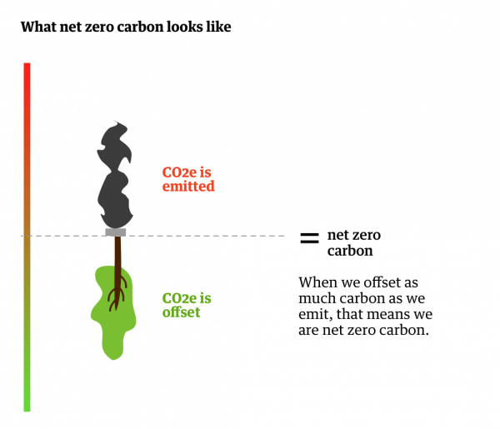
“Net Zero” – the new long-term climate goal?
There is a growing global push for “Net Zero” climate targets.
Many governments and corporations have declared “net zero” goals.
President of Climate COP 26, the UK government, has declared intention to create pressure for more net zero targets to be announced.
Many portray this as a positive signal that the world is on track to avoid runaway climate breakdown.
We need to dispel this myth as net zero is not real zero, and delays real action in the North
Far from signifying climate ambition, the term ‘net zero’ is being used to orchestrate escape clauses so as to evade historical responsibility, shift burdens, disguise climate inaction, and delay taking measures – or even to justify scaling-up of extraction and burning of fossil fuels.
Source of diagram – zerocarboncapital.nz

Slide 3


Green washing ?
The ‘net’ component means that countries can use dubious accounting to continue polluting as normal, while relying on the irresponsible notion that the vast amounts of carbon they release will be sucked out of the air by some other means, often in some other country done by someone else entirely, to ‘offset’ their continued emissions.
The North will rely on carbon trading schemes in which other countries (usually in the South) who are paid to do emission-reducing activities on their behalf.
Carbon trading schemes mean that these countries can continue business-as-usual without making the changes necessary, and still claim to be on track for ‘net zero’ emissions - even as they use up the remaining planet’s carbon budget and put the burden for action onto poorer countries and communities in the South.
In addition, the South will have to do more emissions reductions over and above the carbon credits that they will sell to the North in achieving their own Nationally Determined Contributions (NDCs) submitted under the Paris Agreement on climate change.
This leads to in-equity, with the North not doing their fair share in emissions reductions.

Slide 4
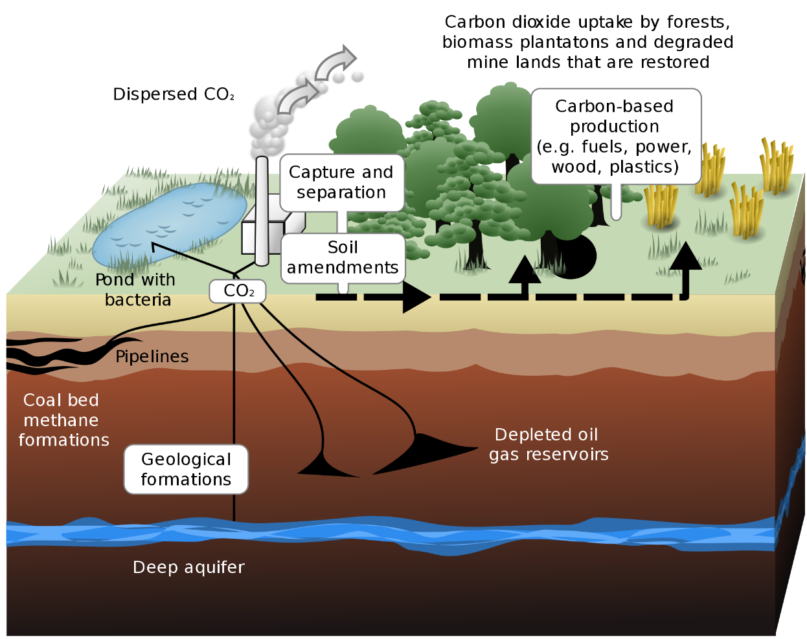
Net Zero: is there a legal basis?
The term net zero is not in the UNFCCC or the Paris Agreement.
There are references on the need for governments to implement programmes that address emissions by sources and removals by sinks, BUT the term ‘net zero’ as a goal or target is non- existent.
Removals of emissions is necessary to stay below 2C or 1.5 C temperature rise
What are removals by sinks?
They are land-based:
  ecosystem-based approaches: forests, grasslands, wetlands
  Large-scale afforestation
Simplistic view: by the second half of the century (2050), any ongoing emissions must be balanced by an equivalent level of sequestration.
It’s more complicated than just subtracting removals from emissions. We should not think in terms of “net”.
Key is understanding the distinction between fossil carbon (fossil fuel burning) and terrestrial (land-based) carbon / cycles

Slide 5
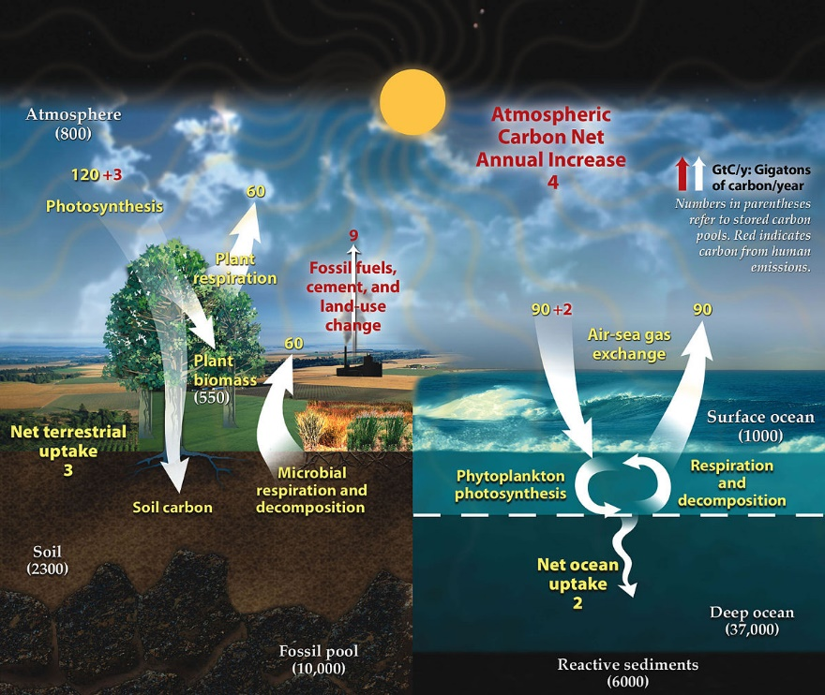
Net Zero - continued
As the capacity of forests and other ecosystems to sequester carbon is finite, this goal means we need to bring emissions as close to zero as possible including from deforestation.
Also of concern is whether this notion of balance in emissions and removals by sinks opens the door for a form of geoengineering known as carbon dioxide removal
Large-scale monoculture plantations or bioenergy crops with carbon-capture and storage used to remove carbon from the atmosphere? (known as Bioenergy carbon capture and storage or BECCS)

Slide 6
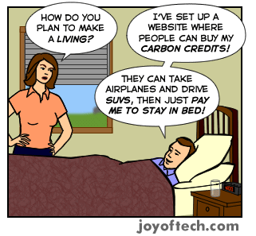
Paris Agreement opens door for global carbon market
Japan, New Zealand, Norway and Switzerland have expressly stated in their Nationally Determined Contributions (with 2030 duration) that they will rely on carbon markets and offsets under the Paris Agreement to achieve their emission reduction targets.
The carbon markets will be a crucial vehicle for the North’s net-zero targets, through the use of offsets in the South.

Slide 7
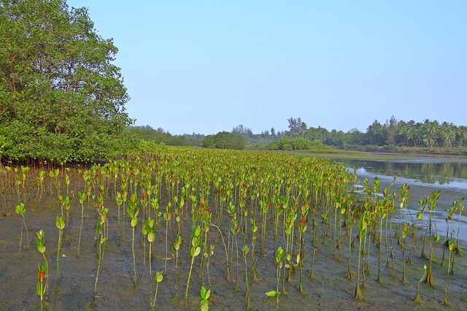
Nature-based solutions
The International Union for the Conservation of Nature (IUCN) introduced the term “nature-based solutions” (NbS) in 2016 - as “actions to protect, sustainably manage and restore natural or modified ecosystems that address societal challenges effectively and adaptively, simultaneously providing human well-being and biodiversity benefits.”
IUCN lists 7 societal challenges in their global NbS standard: climate change mitigation and adaptation, disaster risk reduction, economic and social development, human health, food security, water security, and reversing ecosystem degradation and biodiversity loss.
(Note: Much of the material in this section of the slides come from a forthcoming paper by Dr. Doreen Stabinskly, on ‘’Framing Nature-based Solutions’)

Slide 8
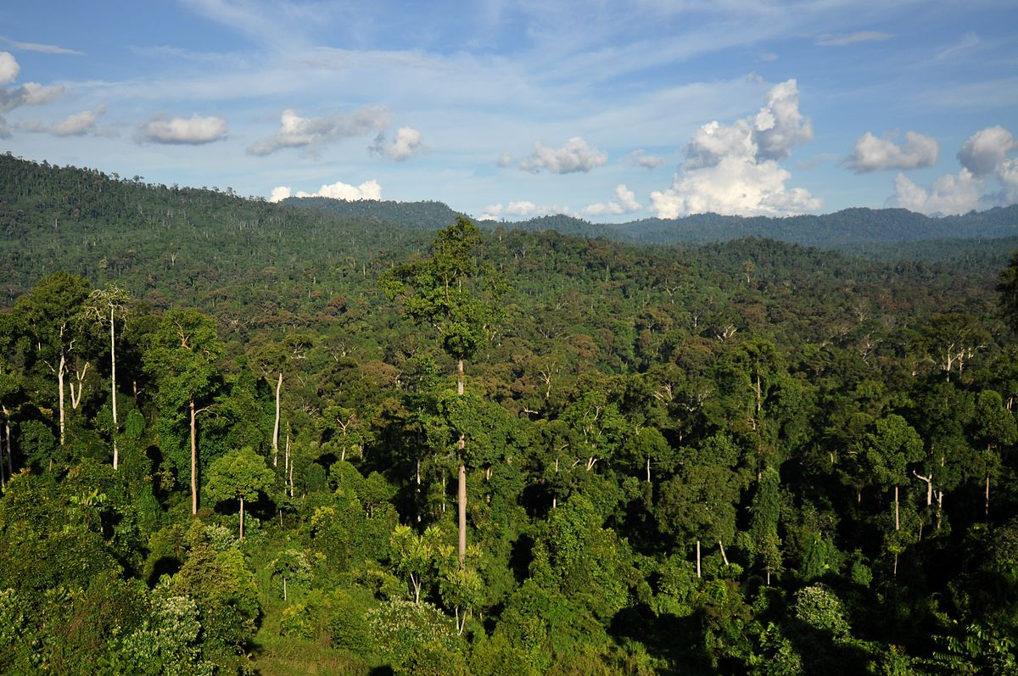
Nature-based solutions (cont.)
NbS per se, in addressing climate change in countries is something that should be encouraged – e.g. ecosystems-based adaptation, forests conservation, mangrove replanting etc.
Concerns arise when the North promotes NbS as sinks/removals in the South for their carbon emissions sequestering. This is where it is linked to net-zero and carbon markets.
The idea being that the North can carry on with their emissions while using the sinks to sequester what they have released.
Business as usual at the cost of Nature, indigenous peoples and communities dependent on forests and agriculture … and climate change worsens.

Slide 9
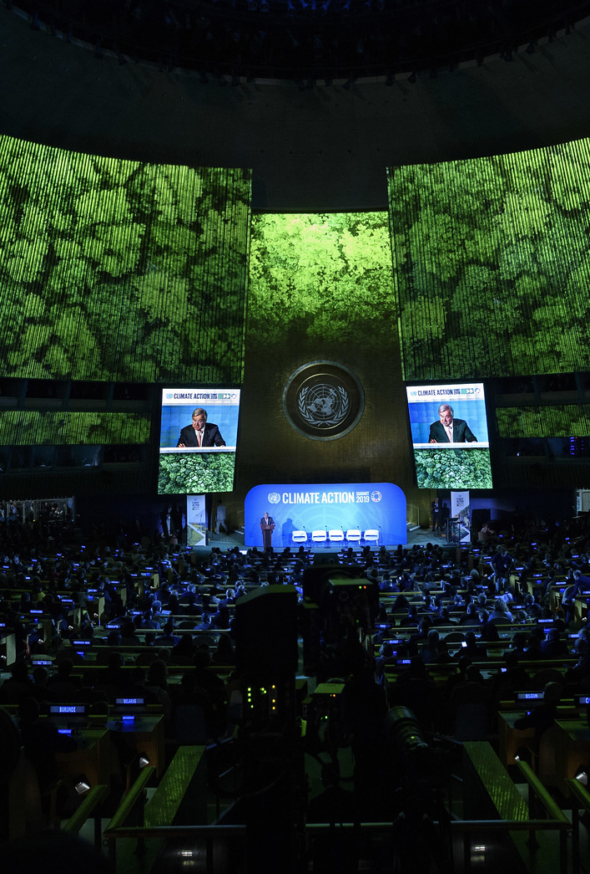
NbS in the UN –
Climate Summit 2019
UN Climate Summit 2019
Convened by the UN Secretary-General
One action track was NbS with one public outcome: a Nature-Based Solutions for Climate Coalition with a Manifesto. A platform for countries and organizations to showcase projects, with 196 projects registered at this point
UNEP and the UN Global Compact along with big Northern environmental NGOs are key players

Slide 10
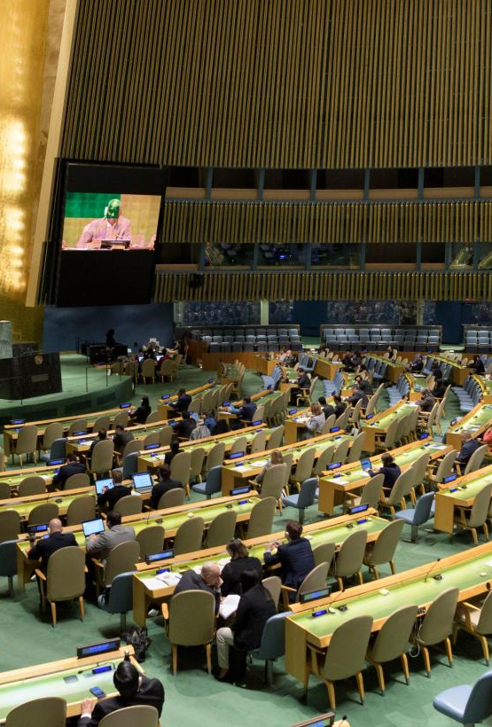
NbS in the UN –
UN Summit on Biodiversity 30 Sept 2020
Convened by the President of the UN General Assembly
One of the issues to be discussed is that “restoration of biodiversity and implementation of Nature-based Solutions will be essential to meet the SDGs.”
“NbS can contribute to climate mitigation and adaptation, food and water security, and to protection from flooding and other extreme events”
“NbS can provide approximately one third of the solutions needed to achieve the climate mitigation targets of the Paris Agreement.”
The documents stress economic value: “NbS provide a proven vehicle for harnessing financial support for biodiversity.”

Slide 11

UN Convention on Biological Diversity, COP15
(October 2021?)
In the 2030 and 2050 goals of the zero-order draft of the post-2020 global biodiversity framework, climate-focused NbS language was included: “… at least [30%] of efforts to achieve the targets of the Paris Agreement in 2030 and 2050’”
Target 7 reads:
“By 2030, increase contributions to climate change mitigation, adaptation, and disaster risks reduction from nature-based solutions and ecosystems based approached (sic) ensuring resilience and minimising any negative impacts on biodiversity.”

Slide 12
CBD expert panel on biodiversity financing
“Government, civil society, and development banks should help to create opportunities for investment in conservation, restoration, and sustainable use of biodiversity in order to develop a pipeline of sound business opportunities with good risk-return profiles, as well as opportunities for impact investing for biodiversity.”
Payment for ecosystem services; biodiversity offsets; nature-based solutions …
“This can include establishing incubators to innovate and pilot new solutions and developing training programmes for potential deal developers, as well as developing new instruments such as green bonds and loans with a more targeted focus on biodiversity and ecosystems, and integrating these into pension funds and capital markets.”

Slide 13
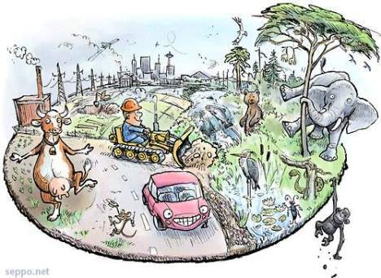
Climate COP 26 presidency priorities
The UK Presidency of COP26 has chosen 5 priority themes: clean energy, clean transport, nature-based solutions, adaptation and resilience, and finance.
Under the so-called “Nature” theme, they are explicitly seeking to link CBD and UNFCCC agendas, noting that they are looking to “maximize linkages between these two agendas and achieve multiple benefits for climate and biodiversity”, including at an operational level.

Slide 14
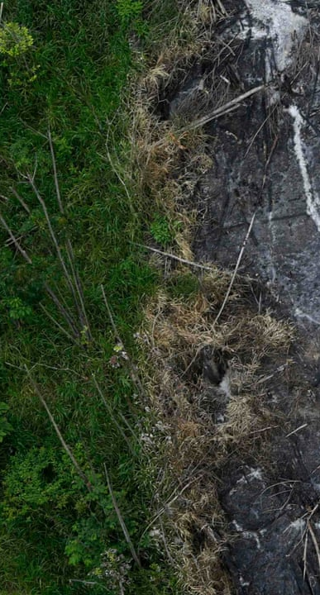
Myths and realities
There is an important difference between fossil carbon (carbon resulting from the burning of fossil fuels) and terrestrial (land-based) carbon.
The “net zero” interpretation of the North has a really critical flaw: it assumes that fossil and terrestrial carbon are interchangeable in the planetary carbon cycle. They are not.
Fossil carbon is NEVER going back into the ground where it came from.
We are extracting carbon that was put into the earth millions of years ago and releasing it into the atmosphere.
It’s not going back to fossil carbon in this geologic age.
Carbon dioxide stays in the atmosphere for hundreds to thousands of years. That’s the core of the problem.

Slide 15
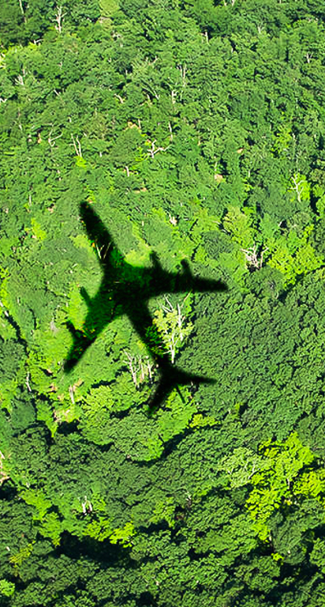
Myths and realities
“You can’t fit the geosphere into the biosphere.” (Pete Smith, a leading IPCC expert on terrestrial carbon says)
We cannot take the carbon released from burning fossil fuels and fit it all into our forests and grasslands and wetlands.
These ecosystems play a very important role in sequestering carbon, indeed, but they are in no way a “solution” to continued burning of fossil fuels.
“Natural climate solutions, like forest management, do not lessen the need for mitigation from energy and industrial sectors.”
There must be two separate and distinct targets for mitigation actions, one for decarbonization, the other for sequestration.
One cannot offset or compensate for the other – fossil and terrestrial carbon are not interchangeable. We must BOTH decarbonize AND sequester.

Slide 16
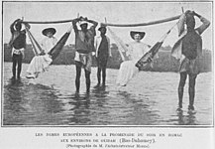
Carbon colonialism?
Seeking ‘solutions’ to one’s emissions in someone else’s lands and forests is ‘carbon colonialism’.
NbS are solutions for what? Whose problems are being solved? Who is profiting from the “solution”? Who put the carbon into the atmosphere in the first place and who should be responsible for removing it?
Deep decarbonization (removing carbon from the atmosphere) by the North and global elites are necessary towards a just distribution of effort to limit temperature rise.
Equitable access to atmospheric & development space: the North has occupied most of the atmospheric space through their cumulative historical emissions. They must start with deep decarbonization on their part and they have to pay the South for the climate debt to enable them to shift to a low-emissions sustainable path.

Slide 17
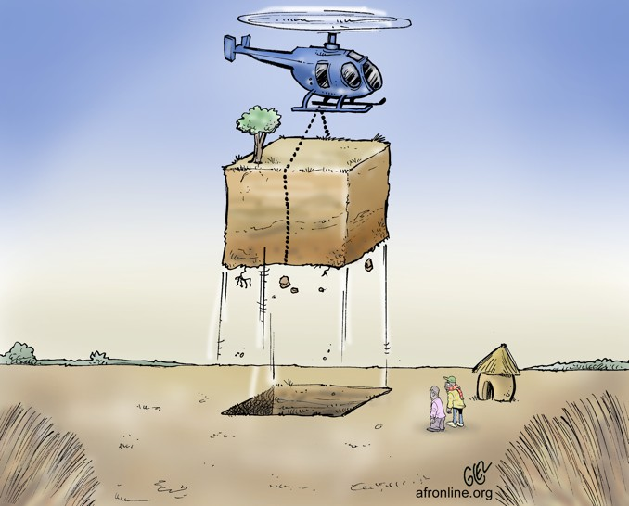
Relying on NbS creates huge demand
No published research exists yet that adds up the quantities of carbon removal that make up the net zero pledges of corporations and governments.
The quantity will be huge and likely to exceed the sequestration capacity of the planet by several fold.
Much of the sequestration capacity is in the sinks of the South and this leads to possible ‘land and forest grabs’, in the name of climate and biodiversity solutions. Who will ‘own’ and benefit from these NbS?
What looks positive initially can balloon into negative impacts for the South, especially the poor communities who depend on the land and forests for their livelihoods and resources.

Slide 18

Next steps
Need to understand the underlying agendas on the use of Net-Zero and Nature-based Solutions in the global climate and biodiversity negotiations
Who is promoting them and why?
Who will benefit and who will lose?
What do we need to do to prevent bad and negative outcomes?
How do we advance the positive?

Slide 19

www.twn.my
Meena Raman
meena@twnetwork.org
Chee Yoke Ling
yokeling@twnetwork.org
TWN would like to acknowledge the contribution of Dr. Doreen Stabinsky, from the College of the Atlantic for many of the ideas and analysis contained in this presentation.

